Slide 1
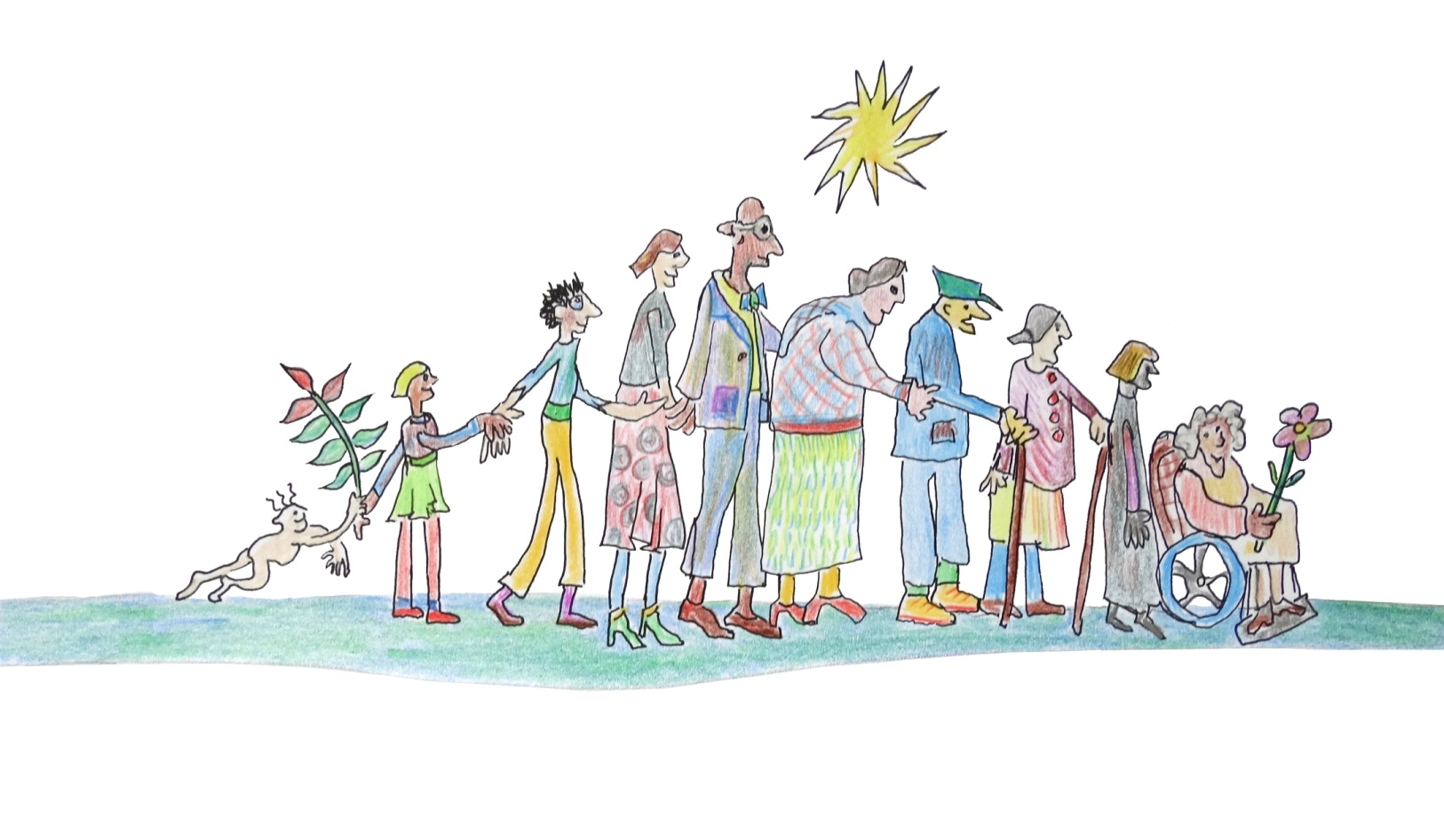
Humanising Healthcare:
Patterns of hope for a system under strain
Dr Margaret Hannah
Deputy Director of Public Health
NHS Fife
Visiting Professor, Robert Gordon University

Slide 2
What’s on your mind?
Take five minutes with one or two others and discuss what’s on your mind

Slide 3
What lies behind what’s on your mind?
In five minutes again, in your small group of twos or threes discuss what might lie behind the thoughts that are on your mind

Slide 4
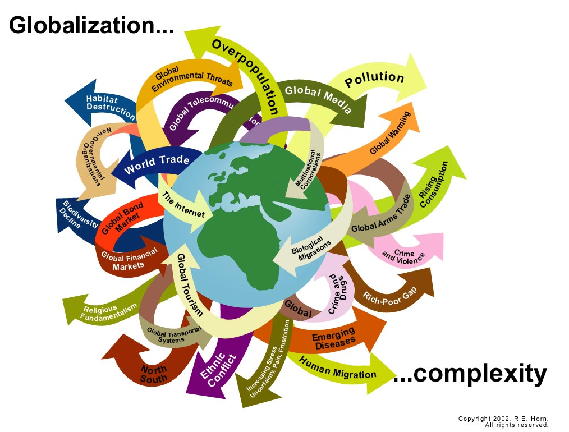
www.internationalfuturesforum.com

Slide 5
www.internationalfuturesforum.com

Slide 6
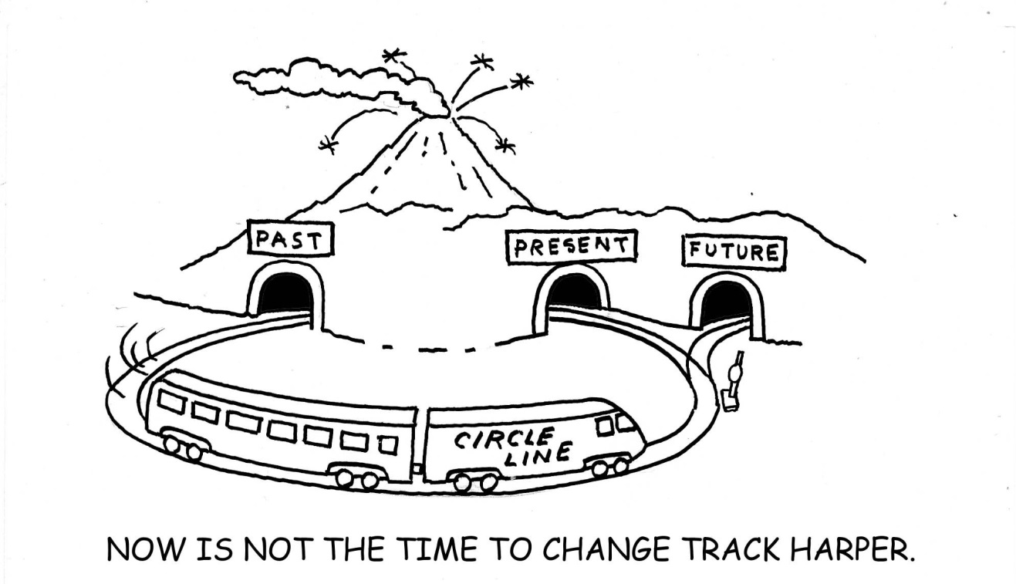
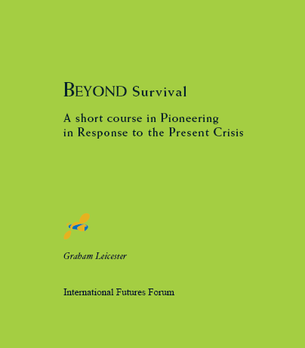
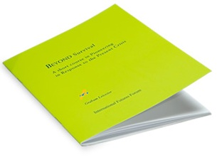
www.internationalfuturesforum.com
www.internationalfuturesforum.com

Slide 7
Survivors discard the hope of rescue

Slide 8
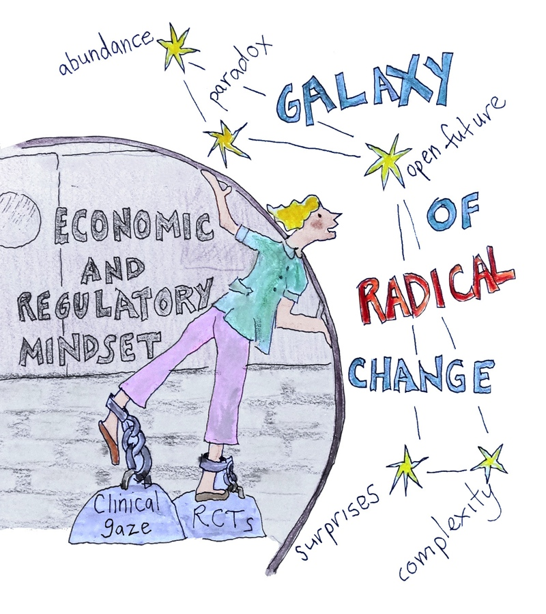
￼￼￼

Slide 9
Three Horizons Framework
VIABILITY
radically different operating environment
new paradigm
fits and takes off
Increasing signs of strain and system failures
innovation shifts allegiance
HORIZON 1
less
disruptive change
Innovation to try and keep things going
Radically new ideas with better fit to new environment
HORIZON 2
new context for
useful old ways
THE TURBULENT TRANSITION
HORIZON 3
NOW
www.internationalfuturesforum.com
TIME

Slide 10
The future is already here: Southcentral Foundation, Alaska,
“We don’t think about specific diseases, but relationships”
“Diseases don’t have people, people have diseases”
“It’s not just someone with medical problems, this was Miss Alice”
3 types of consultation room, ICT support
“Building and sustaining relationships is not that easy”
“I’m a recovering physician” – training the workforce

Slide 11
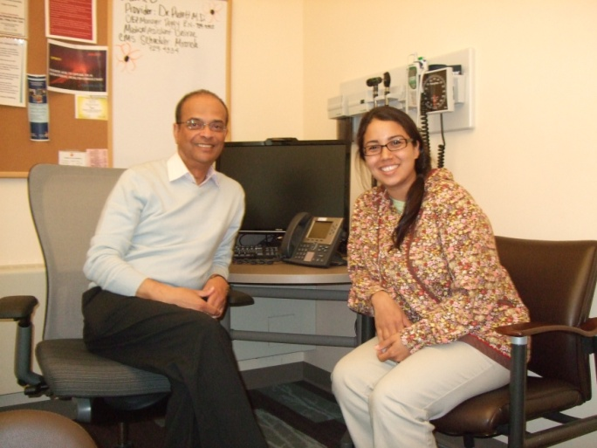
Talking Room

Slide 12
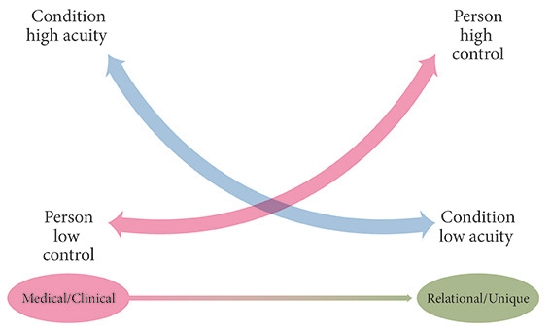

Slide 13
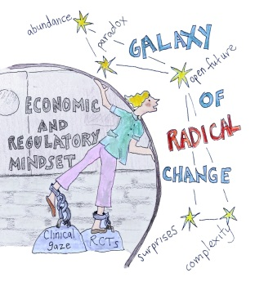
Shift in mindset
Belief now
We have to change first to facilitate change in others.
We do not need more staff but we need to work differently, in a more integrated way and in real partnership with our community.
Belief in the past
People have to change,
not us.
We need more staff.

Slide 14
Shift in mindset
Belief in past
We are trained to provide health and social care but are being asked to provide psycho-spiritual care.
Only if we are doing something are we providing services.
Belief now
We can’t provide health and social care without exploring people’s hopes for the future – what matters to them, what gives them joy in their lives, helps them thrive, not just survive.
Good quality conversation is itself of great value and a service to another human being.

